Slide 1
The Personality of the Politically Ambitious
Adam M. Dynes • Hans J. G. Hassell • Matthew R. Miles
Polit Behav (2019) 41:309–336 https://doi.org/10.1007/s11109-018-9452-x

Slide 2
Agenda
Introduction
Data
Replication of results
My contribution
Conclusion

Slide 3
Introduction
Interested in investigating the effects of personality on a person’s ambition to run for office
Utilises the Big 5 model (McCrae & John, 1992)
Openness, Conscientiousness, Extraversion, Agreeableness, Neuroticism (Emotional Stability)
Differentiating Nascent Political Ambition and Progressive Political Ambition

Slide 4
Introduction - Hypotheses
Direct quotes from paper (Dynes et al., 2019)
“H1a (Extraversion and Political Ambition)
Individuals with higher levels of extraversion will be more likely to express nascent political ambition.
H1b (Extraversion and Progressive Ambition)
Local officials with higher levels of extraversion will be more likely to express progressive ambition.”
“H2 (Openness and Political Ambition)
Individuals with higher levels of openness to experience will be more likely to express nascent political ambition”
“H3a (Agreeableness and Political Ambition)
Individuals with higher levels of agreeableness will be less likely to express nascent political ambition.
H3b (Agreeableness and Progressive Ambition)
Local officials with higher levels of agreeableness will be less likely to express progressive political ambition.
H3c (Agreeableness, the Likelihood of Winning, and Progressive Ambition)
Local officials with lower levels of agreeableness will be more likely to express progressive ambition than local officials with higher levels of agreeableness as their perceived probability of winning higher office increases.”
“H4 (Emotional Stability and Progressive Ambition)
Local officials with higher levels of emotional stability will be more likely to express nascent progressive ambition.”

Slide 5
Data
Study 1
Study 2
1939 complete observations (general public)
DV: Factor with 3 levels
Actively considering running for public office
Open to the possibility of running for public office
Absolutely no interest
1679 complete observations
Sample of elected mayors and legislators
DV: Factor with 4 levels (Q about running for higher office)
Something I would never do
Would not rule it out, currently no interest
Might undertake if opportunity was there
Definitely

Slide 6
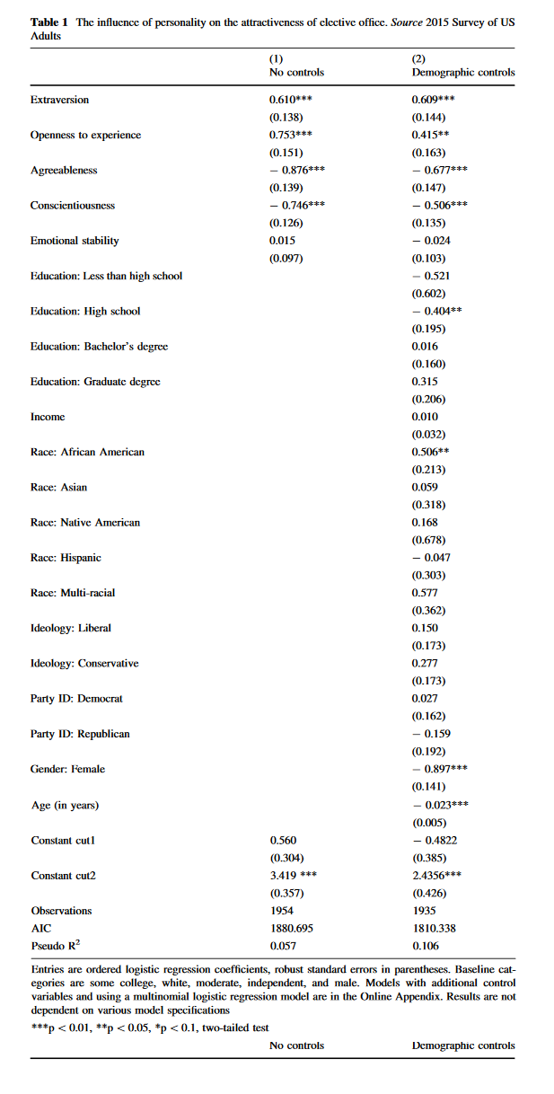
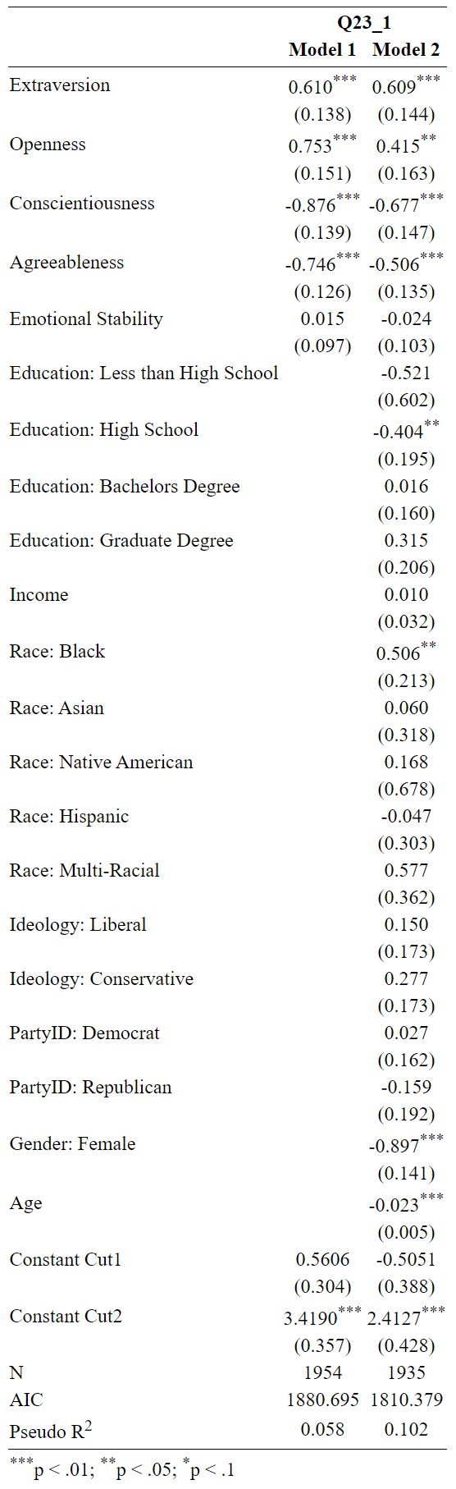
Replication Study 1 – Table 1

Slide 7
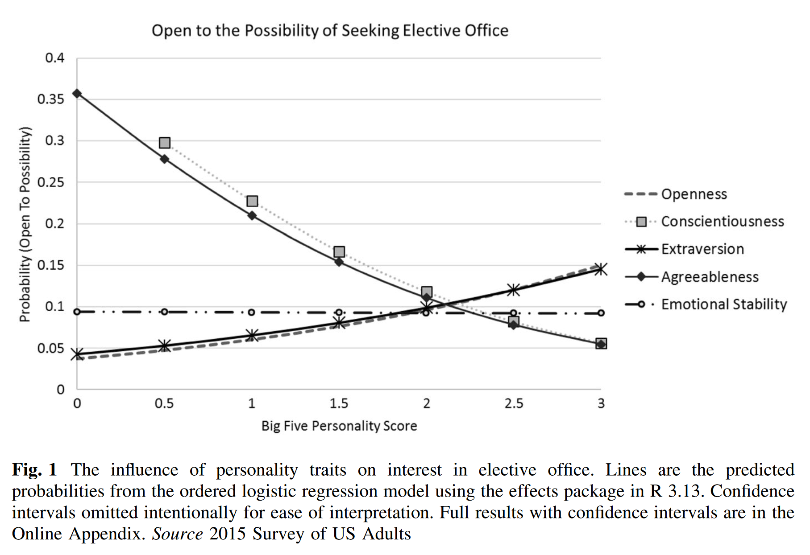
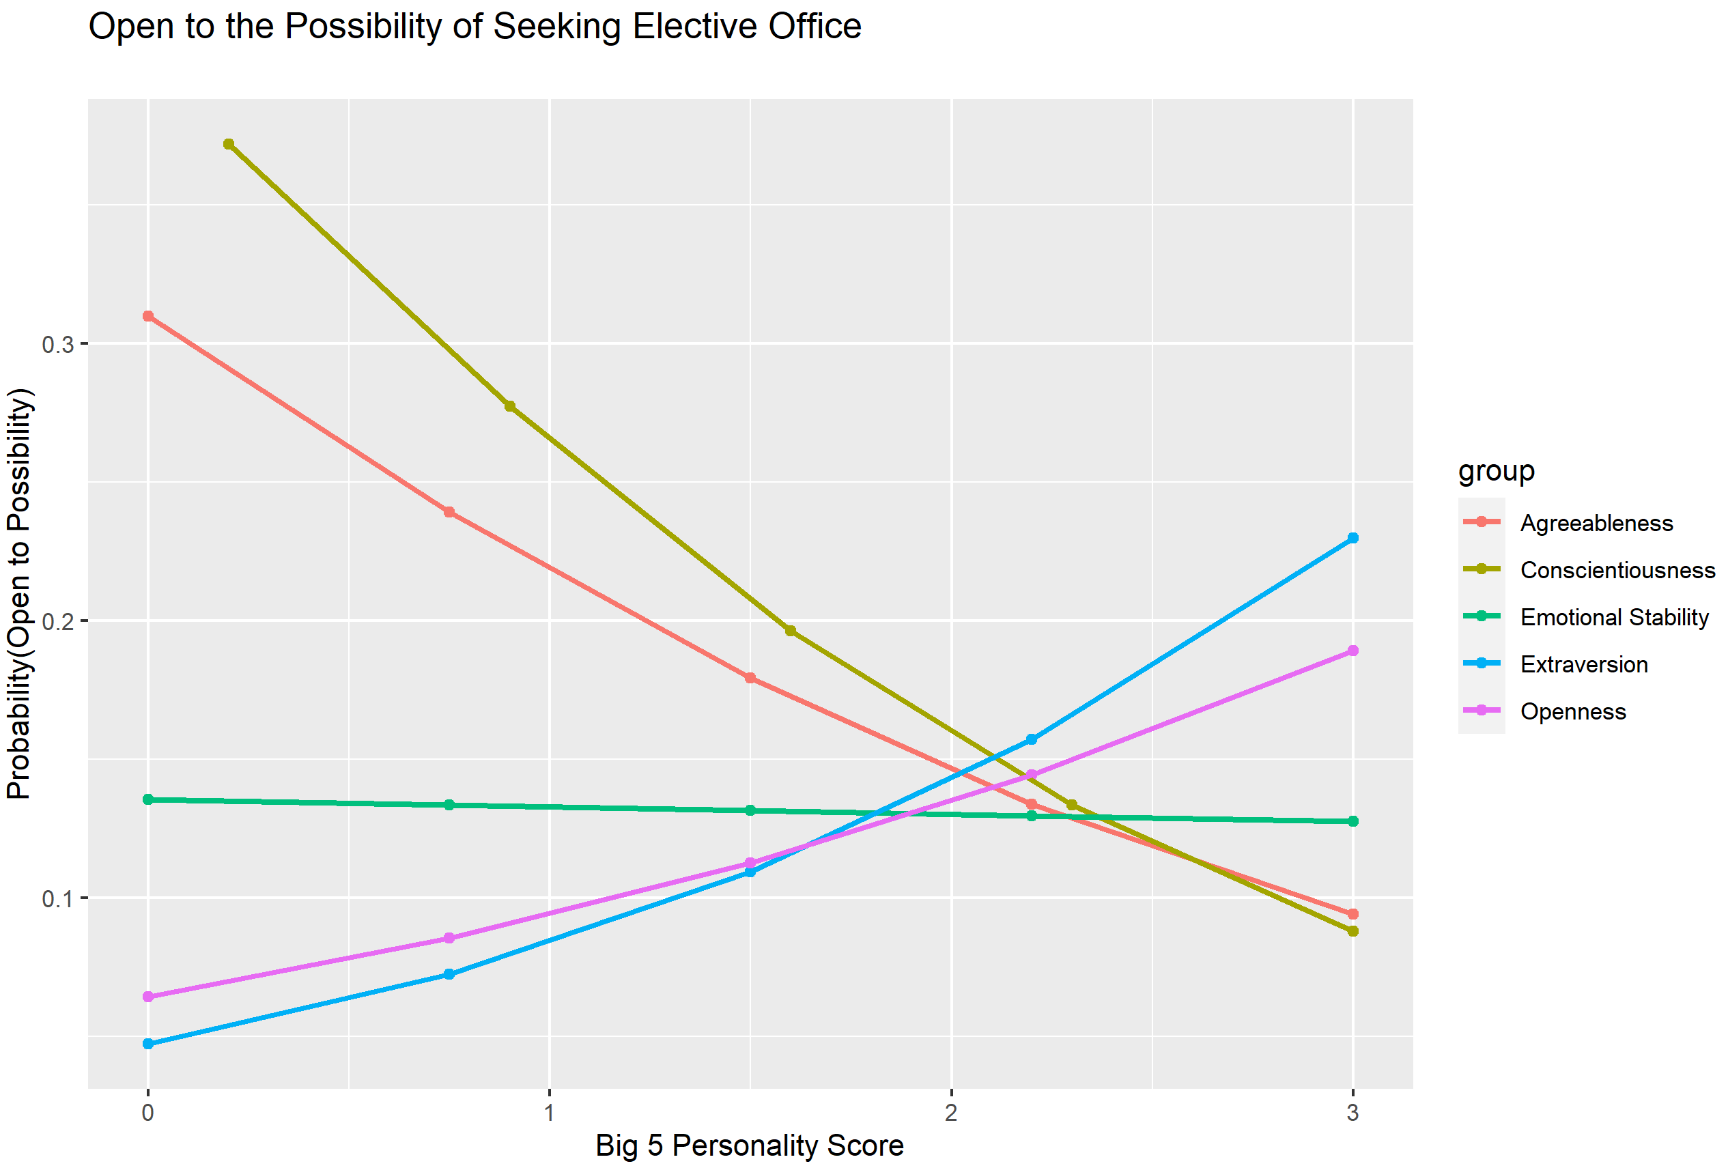
Replication Study 1 – Figure 1

Slide 8
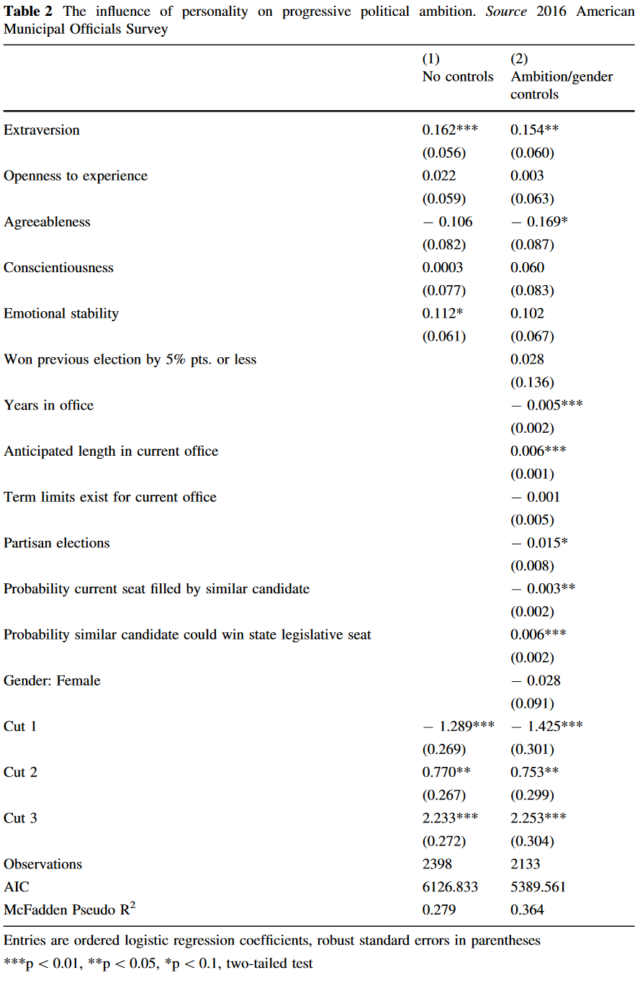
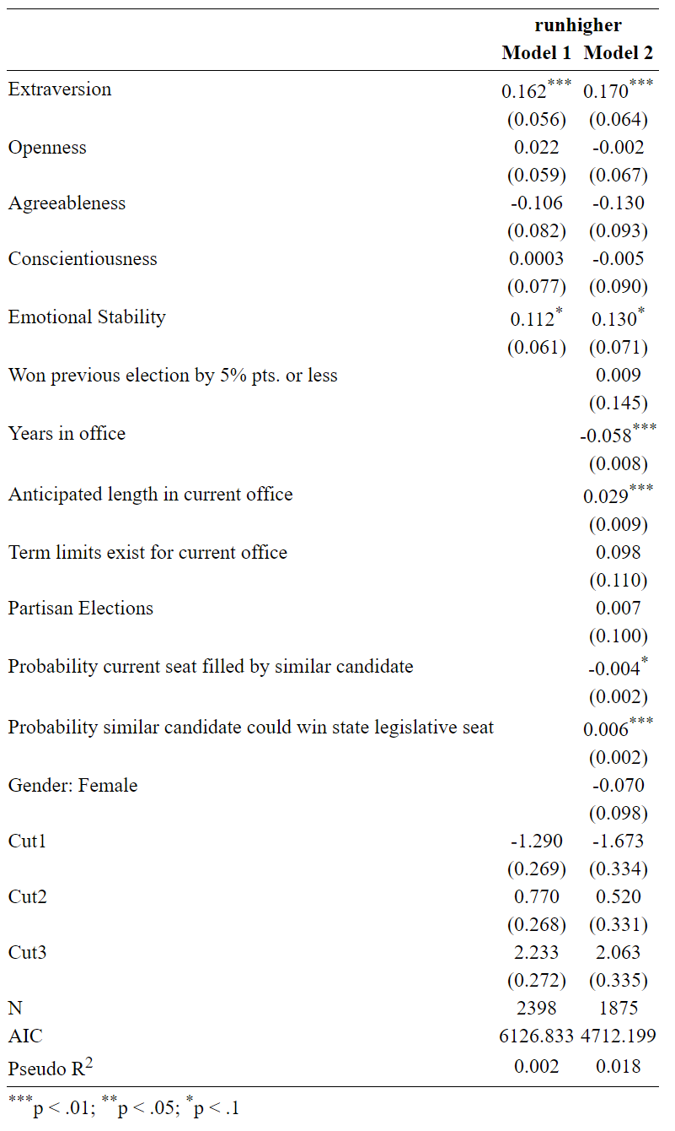
Replication Study 2 – Table 2

Slide 9
Findings of replication
As you can see, was not able to exactly replicate the second model, despite using the same code as the replication file
Possible explanation:
Number of observations cut way down compared to original study
Affected results, replication did not find significance for one covariate
R removing NAs?

Slide 10
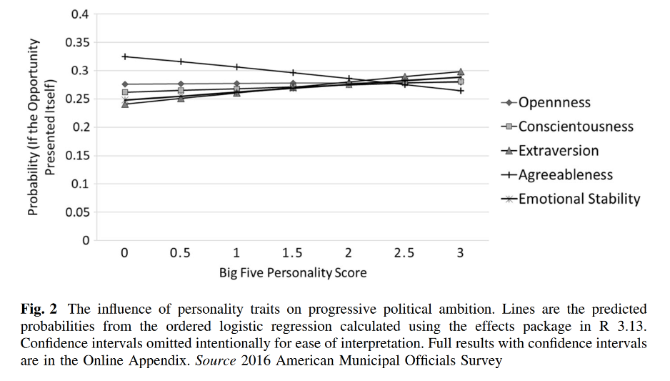
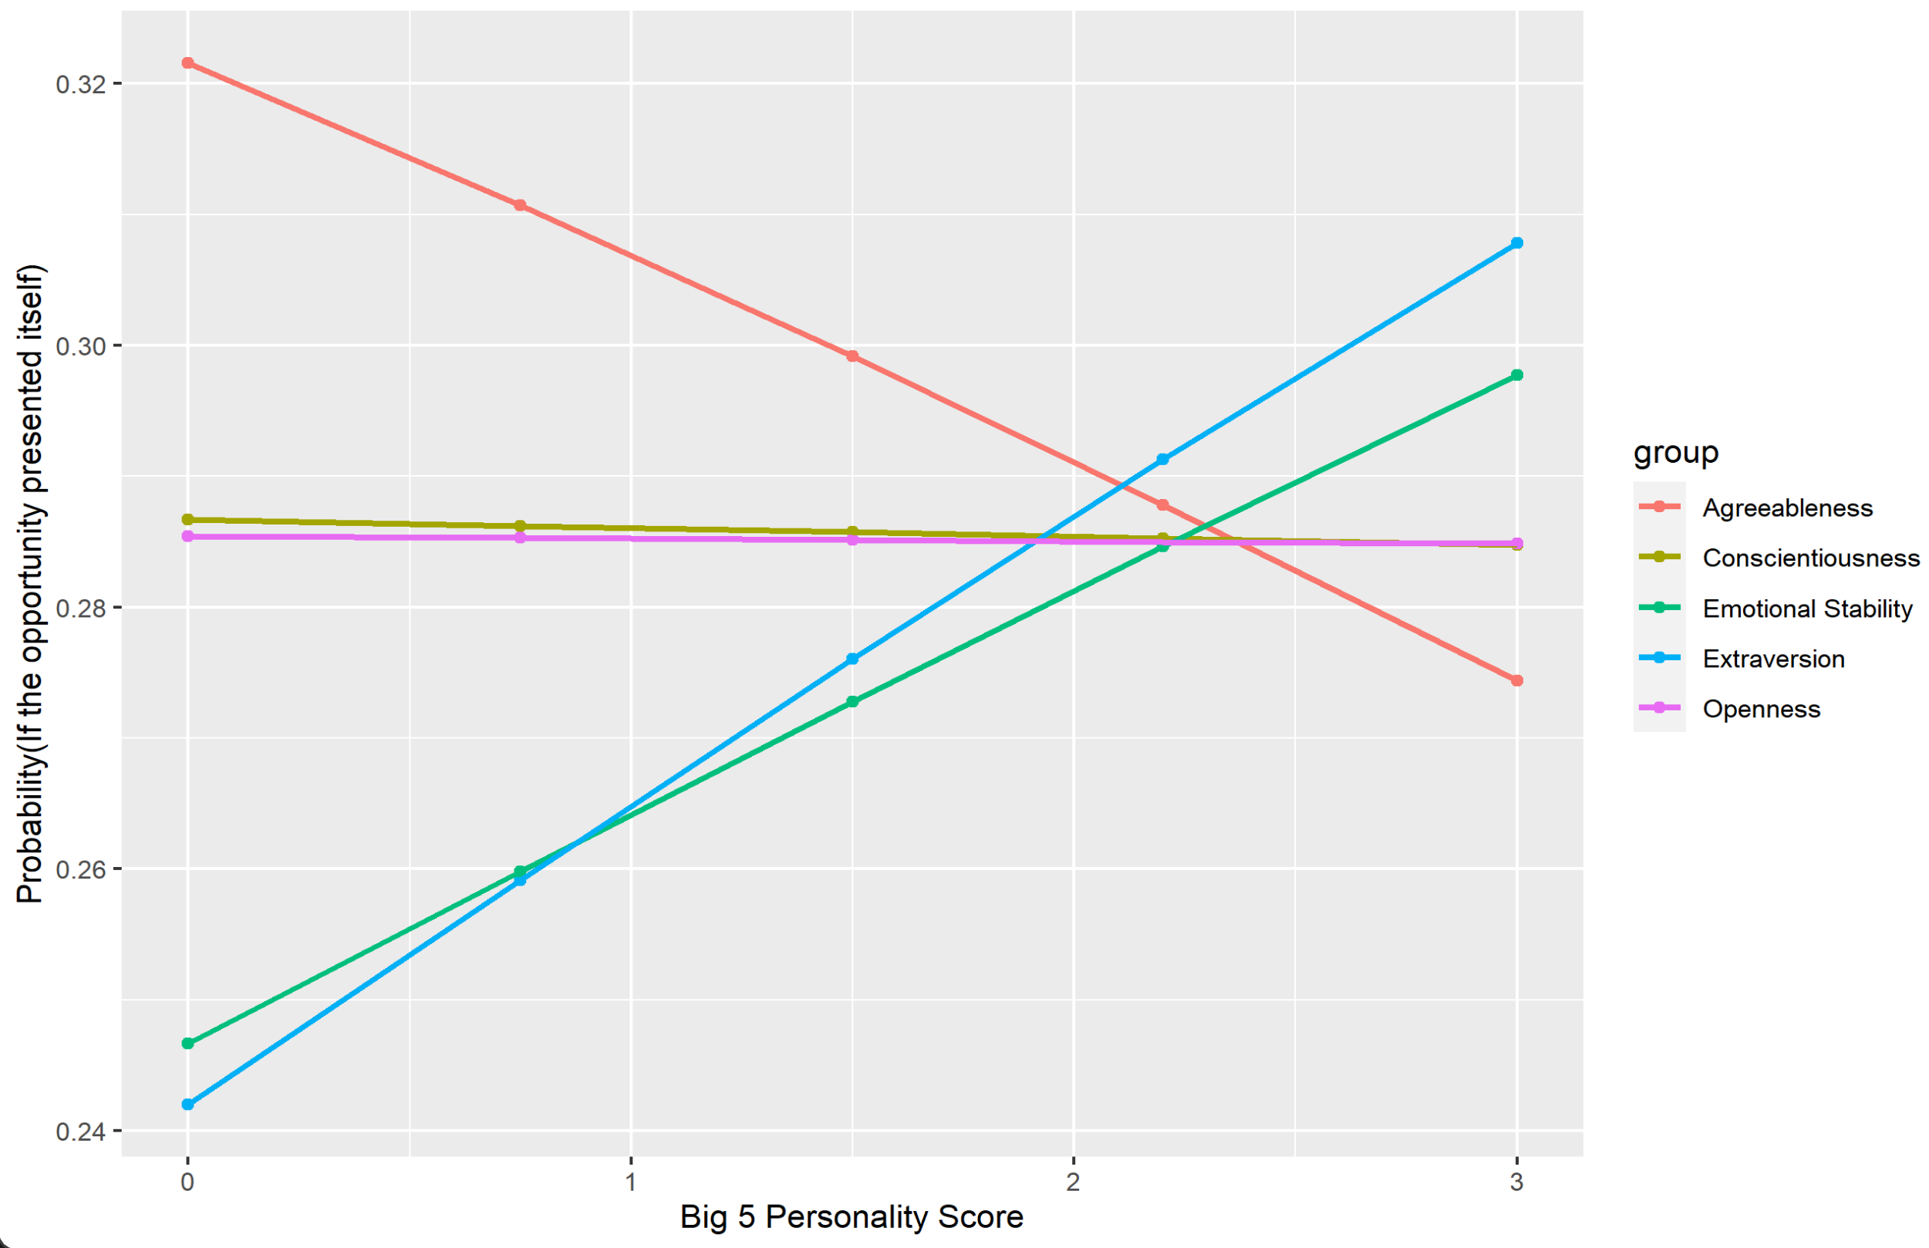
Replication Study 2 – Figure 2

Slide 11
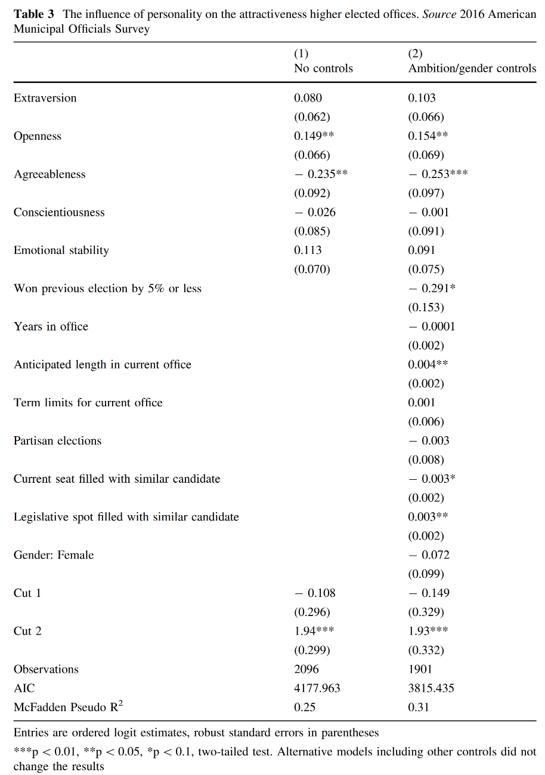
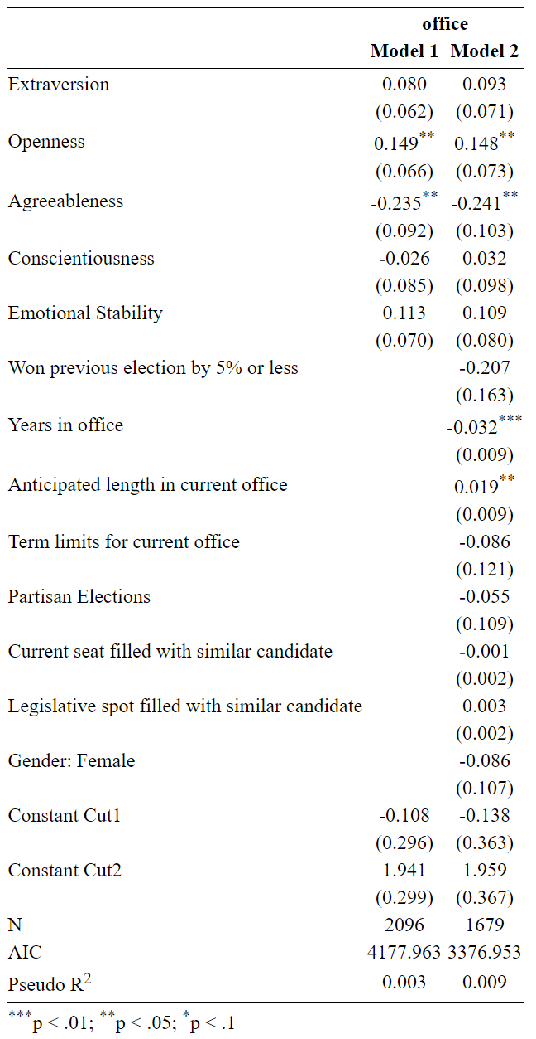
Replication Study 2 – Table 3

Slide 12
Findings of replication
Same as the previous table – less observations
‘Years’ covariate significant in replication, not in original
Also another interesting finding, Pseudo R-Squared values very different

Slide 13
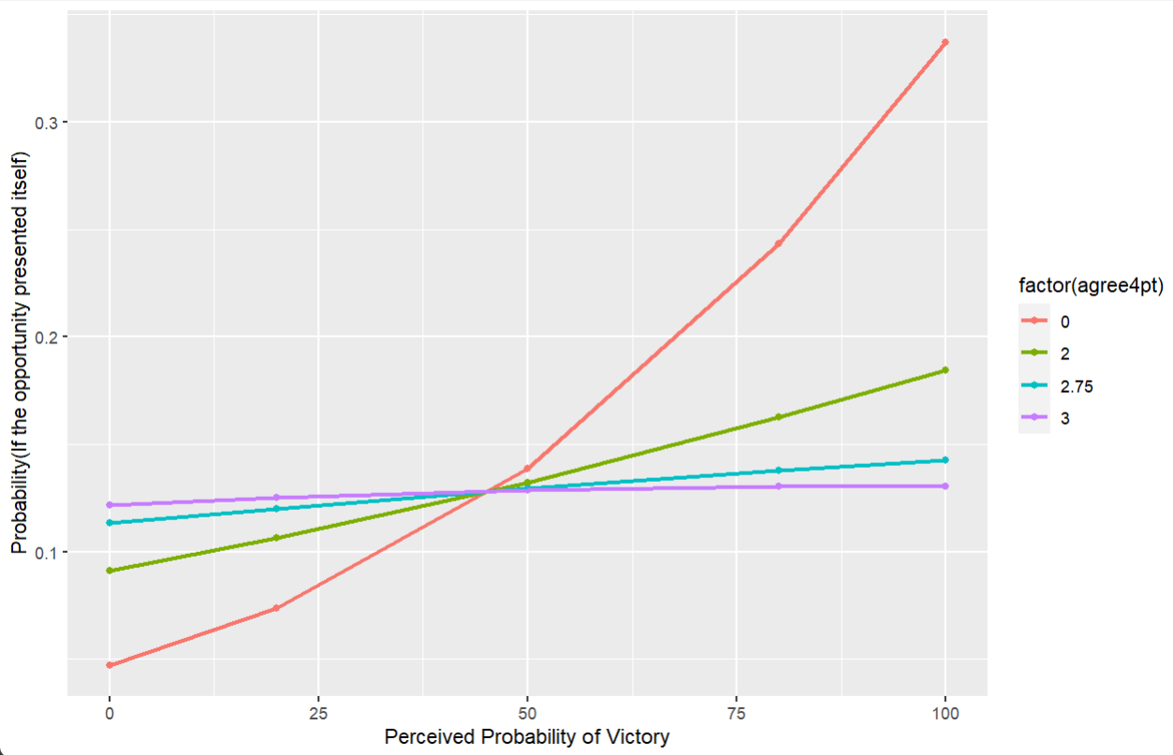
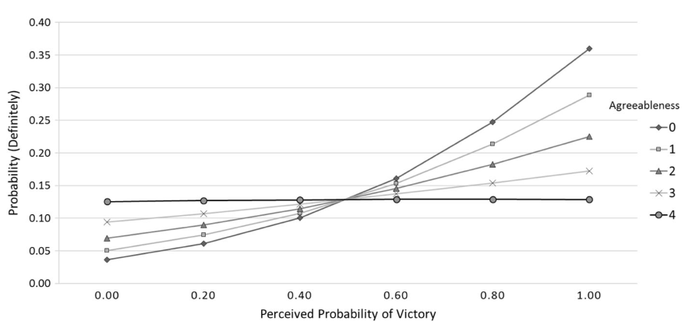
Replication Study 2 – Figure 3

Slide 14
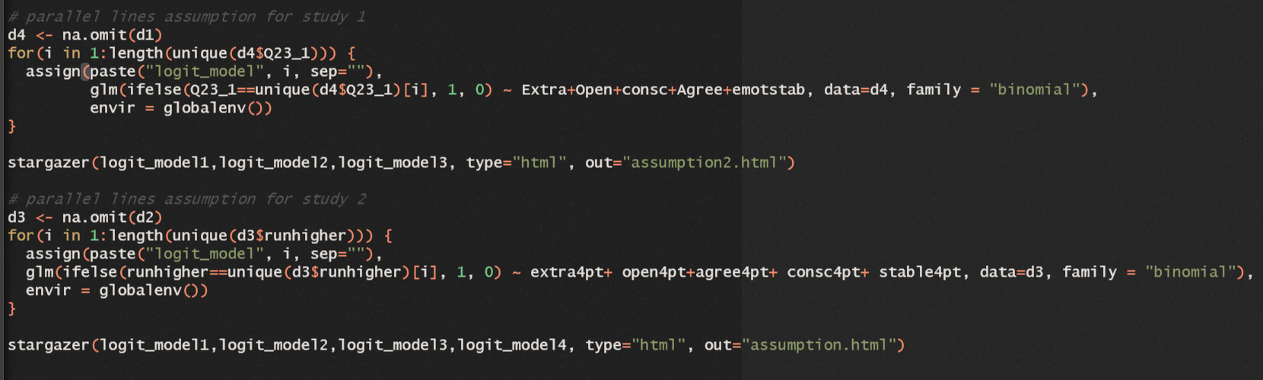
My contribution – Parallel lines
Researchers made a LOT of models
For every ordered logit model they ran, they also ran an unordered multinomial model
Regardless, important to check whether the assumptions of the model stands
Proportional odds assumption:
Assumes coefficients are consistent throughout the different categories

Slide 15
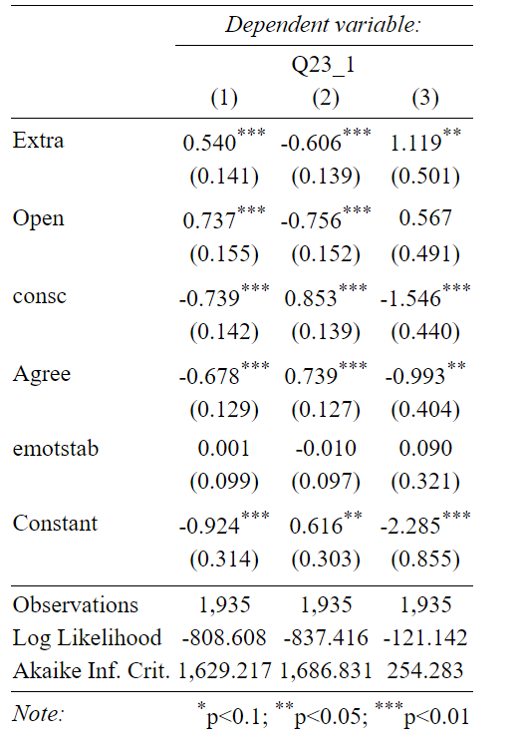
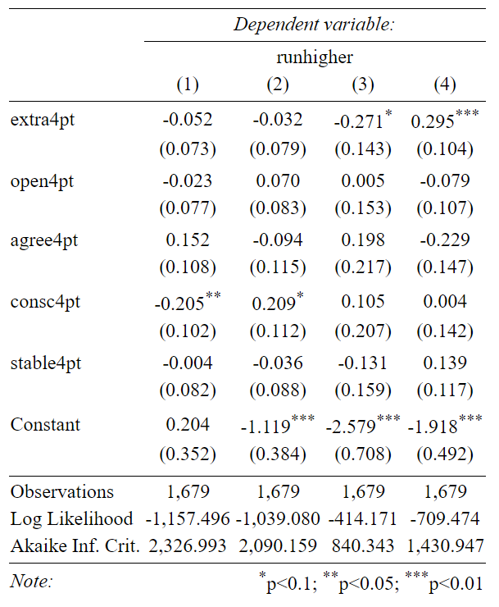
My contribution – Parallel lines
Nascent political ambition
(Study 1)
Progressive political ambition
(Study 2)

Slide 16
Conclusion
Was able to reproduce statistically significant findings
However, was not able to get the same figures – messy replication file
Pseudo R Squared values were not reported in main paper, generally quite poor
Ordered logit models violated proportional odds assumptions, but multinomial models produced the same results (any need for ordered models?)

Slide 17
References
Dynes, A. M., Hassell, H. J. G., & Miles, M. R. (2019). The Personality of the Politically Ambitious. Political Behavior, 41(2), 309–336. https://doi.org/10.1007/s11109-018-9452-x
Kim, J.-H. (2003). Assessing practical significance of the proportional odds assumption. Statistics & Probability Letters, 65(3), 233–239. https://doi.org/10.1016/j.spl.2003.07.017
McCrae, R. R., & John, O. P. (1992). An Introduction to the Five-Factor Model and Its Applications. Journal of Personality, 60(2), 175–215. https://doi.org/10.1111/j.1467-6494.1992.tb00970.x

